Slide 1

Blockchain
Sunitha R
Department of Computer Science and Engineering

Slide 2

Blockchain
HYPERLEDGER FABRIC ARCHITECTURE
Sunitha R
Department of Computer Science and Engineering

Slide 3


















Blockchain
Hyperledger Fabric V1 Architecture
External-CA
Fabric-CA
Membership
Services
✓
optional
optional
✓
Admin
Peer
Endorser
Client Application
SDK (HFC)
Committer
O O
Ledger Chaincode Events
A
B
O O
Ordering-Service
!
Hyperledger Fabric Network

Slide 4
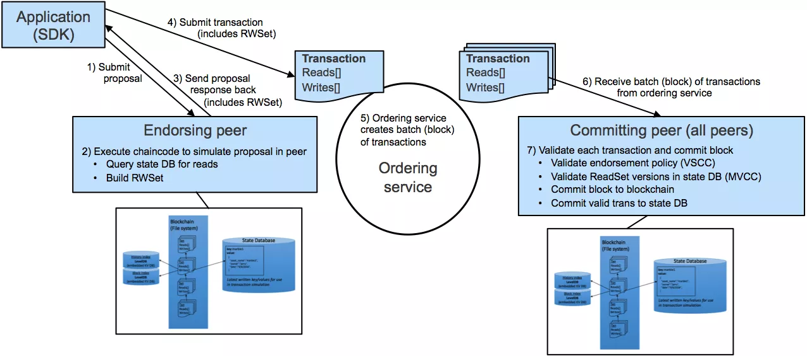
Blockchain
Modular Architecture
Source: IBM

Slide 5
Blockchain
Nodes and Roles
 | Committing Peer: Maintains ledger and state. Commits transactions. May hold smart contract (chaincode).
 | Endorsing Peer: Specialized committing peer that receives a transaction proposal for endorsement, responds granting or denying endorsement. Must hold smart contract
 | Ordering Node: Approves the inclusion of transaction blocks into the ledger and communicates with committing and endorsing peer nodes. Does not hold smart contract. Does not hold ledger.

Slide 6
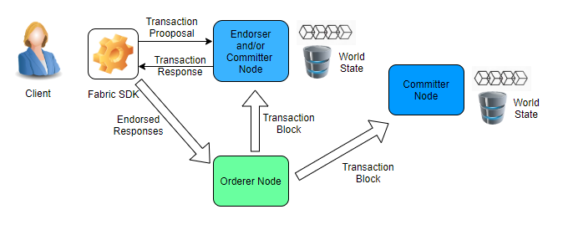
Blockchain
Hyperledger Fabric Basic Transaction Flow

Slide 7
Blockchain
SUPPLEMENTARY READINGS
https://hyperledger-fabric.readthedocs.io/en/release-2.2/network/network.html
https://www.hyperledger.org/
https://www.ibm.com/blockchain/hyperledger

Slide 8
THANK YOU
Prof.Sunitha R
Department of Computer Science and Engineering
sunithar@pes.edu

